Slide 1
Develop an outcome lvl 2
Finn de Lange: 136290212

Slide 2
Links
Trello:
https://trello.com/b/Br5moHU9/chatbot
Drive: https://drive.google.com/drive/folders/1yhpk_0S462LkjxAwOoGV3pgi4VLn9Lmm?usp=sharing
Github:
https://github.com/Susurro-9/chatbot/blob/9506906988ca729f6078c3775bdde145663bebf5/FinndeLange_chatbot.zip

Slide 3
Project management

Slide 4
Project management tools.
I experimented with several different tools: Starting with simply recording my activity in notes on my computer, which proved to be a slow and inefficient process, so I jumped ship to Monday.com, which doesn’t have a freemium option so I ended up using Trello. Trello was excellent for my project management as it allowed me to visualise my project across multiple categories that I could easily identify and work from. I began by setting up a board with three categories (shown below) and adding all my tasks into the to do list. Whenever I started a new task I moved it to the doing list and stuck at it until I was satisfied with moving it to the Done/For review section, where I would later revisit the project. I would later add a fourth category.
Trello is also highly recommended as a board for Kanban methods.
https://trello.com/b/Br5moHU9/chatbot

Slide 5
Kanban
Without even realising, I had been using the Kanban software methodology for my entire project.
Kanban is an excellent framework for software development based on agile and DevOps software development. The key aspects of Kanban centre around the board and the cards. I used four key columns in my Kanban board made on Trello: To do, doing, for review and done. The fifth column was just to remind me what I was working towards. Cards on the kanban board were all made to be around similar workloads so that each day I would be able to knock off similar amounts of work and progress steadily with a clear path. Each day I reviewed the board tp decide what needed to be done and what I could move around the columns.

Slide 6
Kanban rules
These rules mean very simple things.
Do not pass features that are not working, this slows down the entire process and wastes time for you and your team (if you have one).
If you are downstream at the time (have space to take on more features to work on) don’t over pull and take on too many responsibilities that you won’t be able to finish in a timely manner, or you risk slowing down production.
The third rule is really simple: Produce what you need, as there is no need to over engineer and spend more time than necessary creating something with capabilities that will never be used.
The fourth rule only applies to team situations, but it means to make sure that all stages of production happen at similar rates to prevent bottlenecks. My equivalent of this was to prevent any one list on my board getting too bogged down at a given time.
Once the fourth rule is successfully running, the fifth states to simply maximise efficiency of the fourth.
The sixth rule states that during optimisation and quality assurance you should document the process as a way to verify if the process is properly optimised. If it is, then the system should achieve stability.
Kanban has six key rules:
Never pass defective products.
Take only what’s needed.
Produce the exact quantity needed.
Level the production.
Fine tune production/process optimisation.
Stabilize and rationalise the process.
For my personal uses I couldn't use the full kanban system as it is meant for agile software development as a team. So i adapted it for personal use, this meant aspects such as streamlining and optimisation were changed as there was no components changing teams during development so no bottlenecks could form at this point.

Slide 7
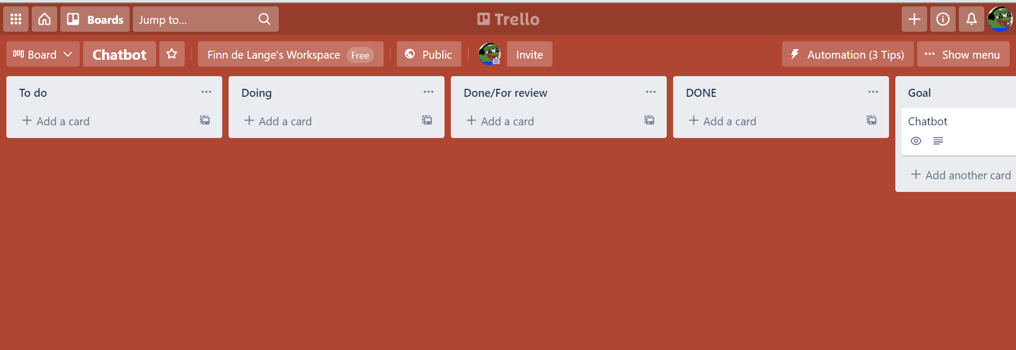
My board.

Slide 8
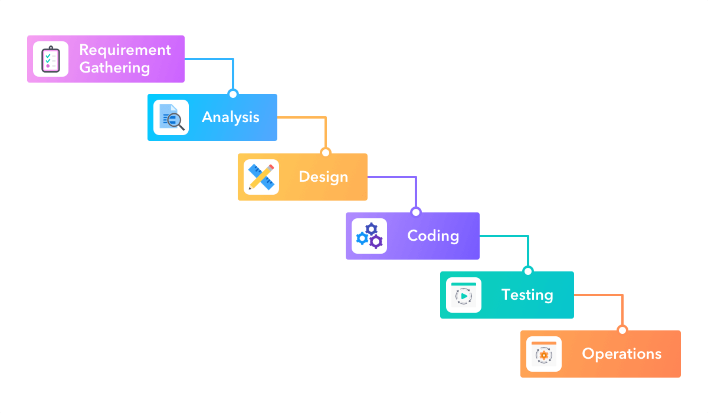
Techniques.
Most software development techniques were illogical for me to use.
Methodologies such as scrum, lean and agile are all designed for a team oriented setting, whereas I was working by myself, occasionally asking people to try and break my code.
I wanted to use a method that involved heavy planning so that I would have a clear goal, understanding and idea of where I was at and what my next steps were. To meet this, I used waterfall techniques.
Waterfall is an older more traditional approach to software development as it involves a clear cut sequential process: Assessment, analysis/design, coding, testing and trialing then operations. I merged the analysis and design sections so that I could plan each section in more detail. Since I knew my project would involve multiple iterations, I also used code-test-implementation so that I was certain each unit was to my standard before being completed.
Since I knew my operations section would simply involve sending the file off for marking, I regarded it as the end goal of a fully functional bot that can handle exceptions.
I also used DRY software development to maintain simply clean code.
https://docs.google.com/document/d/1aIliQnwgHz2hm-pcXFD0PHKPBPvHhRwVMuLglKZQxCo/edit?usp=sharing

Slide 9
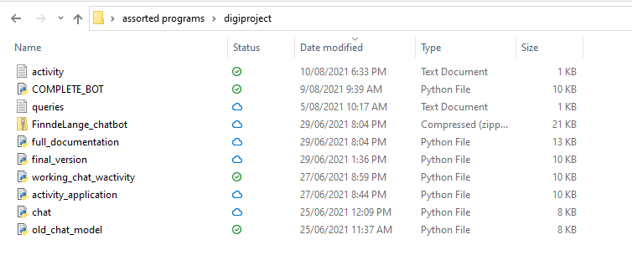
Version control
https://github.com/Susurro-9/chatbot/blob/9506906988ca729f6078c3775bdde145663bebf5/FinndeLange_chatbot.zip
Unfortunately when I recently updated my pycharm it deleted my project I had been working in, including all my files within. Thankfully, I had saved some of the more recent versions, so whilst it does not show the entire process it shows a decent amount of it.
My plan for version control was to write all the code, then access my previous versions using pycharms file history feature. I believed that this was a viable and good plan as it meant I would be able to focus all my efforts into the development of the program and then think about such issues later. Upon reflection, this process was flawed as it meant that issues such as this if they were so to occur could potentially prove dangerous in the course of losing file versions. However, the damage could have been worse and I still have seven versions from when I implemented the more tricky features of my code, so there is good value there.
If I were to repeat the process of developing the whole chatbot again I would make use of more active version control, saving each iteration of the file daily to a new file and storing it.

Slide 10
Decomposing

Slide 11
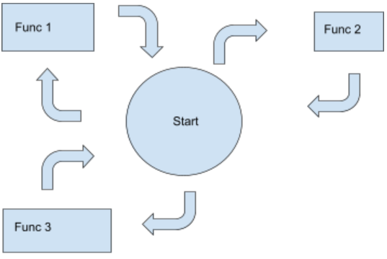
Decomposing
I realised that the most fundamental aspect of my code would be the functions. Since my vision for the program was a modular system where more pathways could easily be added at later stages, I broke the code into two main aspects which I named: the trunk and it’s branches. The trunk is the part of the code that controls everything else, it runs at the start and it controls which functions are called.
The branches are the different functions that are called in order for the user to obtain whatever information they are looking for. The branches are sub decomposable into each of the individual functions for whatever their specific purpose may be.
The decomposition planning was done on documents as this is a digital technology subject.
As a general note: all user inputs are put through the .lower() function to make the comparisons for the user requests easier for the program.

Slide 12
Decomposing cont
Within project management, decomposition is defined as to: “Break down your project scope into manageable chunks. This allows you to control and execute your project deliverable successfully.”
Such my mental map for the program involved a modular network, where different features link into each other via the tree model I created and set out on the previous page, this would be a very easy job to do.
Trunk.
The purpose of this section of my code is simply to start the system and allow the other functions to take over. Here, I’d like to ask the user’s name and confirm that they are in need of help before the rest of the program executes.
Branches.
Branches (assorted functions) will take considerably more time. They are more complex than the starting code and the sheer number I will need will make their development very time consuming. However, to meet my goal of the modular system, it is necessary to do this for at least for a few of the features such that for future development, engineers and developers can see how the architecture links up and how they will need to add their own functions and features to the system. This is also much easier than just making a single big loop as it is cleaner and easier to navigate.
Branches are also sub decomposed into their specific features.

Slide 13
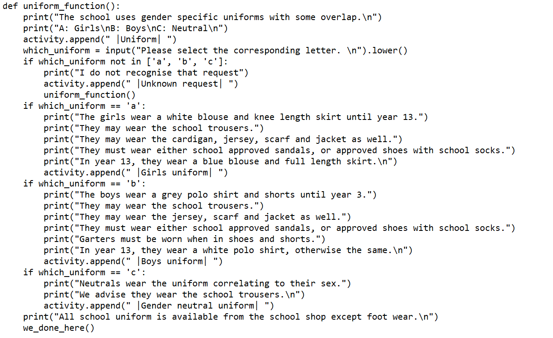
Uniform (decomposition)
The uniform section will be its own function coming off the main section of the starting code as one of the first five options that the bot offers users.
The function itself will require sections providing information on the uniforms of male, female and gender neutral students. This includes tops, pants/skirts, socks, shoes and accessories.
As a function, it will take one parameter being a, b, or c which will determine which option the user wants to find out more about (male, female, GN), then provide the requested information.
Regardless of which option is chosen, it should always display that all uniform exception footwear is available from the school uniform shop, so the print statement for this will sit outside of the rest of the loop.
Finally, the function should loop the user back to the start of the program when it finishes so that the user may find more answers to their questions.
This function took me 30 minutes to complete to my standards.
Within each section, there is the append activity code which adds the pathways followed by the user to the activity list for later appendation to the activity text file.

Slide 14
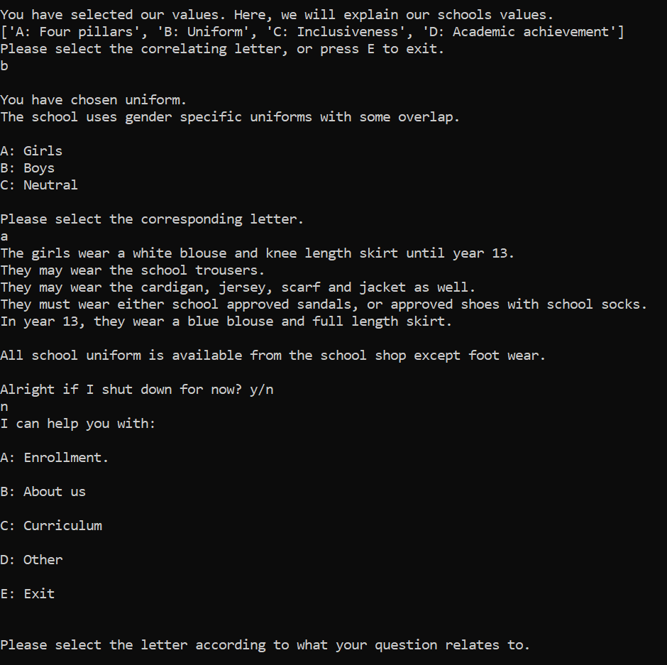
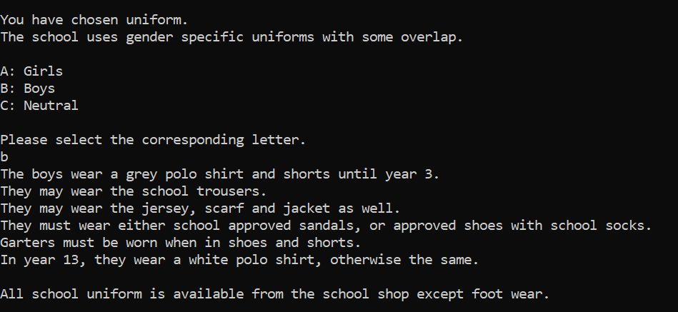
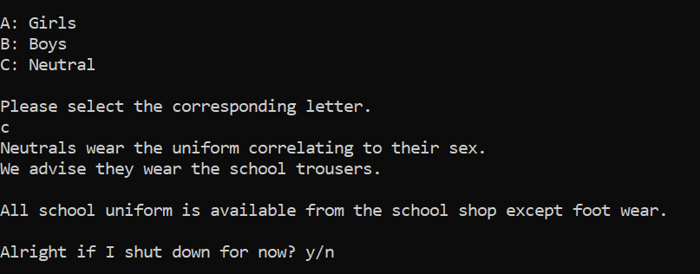
Uniform function in action - (moving clockwise: girls, boys, neutral)

Slide 15
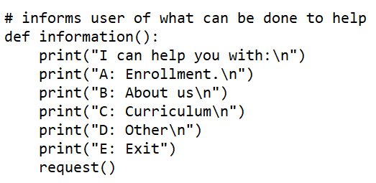
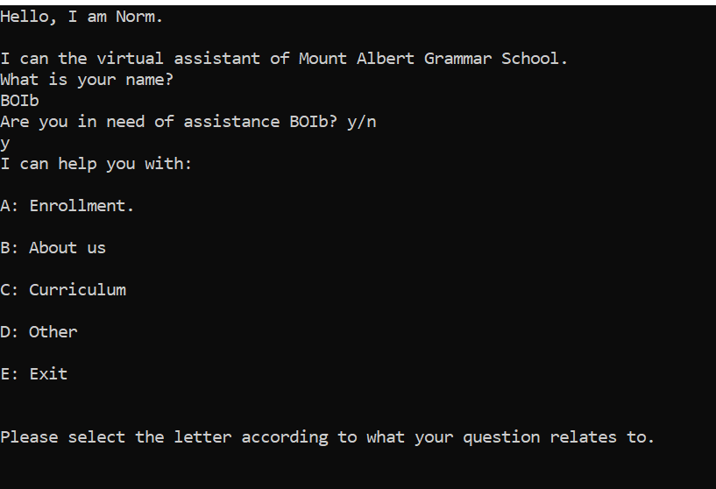
Information (decomposing)
Request (decomposing)
The information function will be one of the most called functions in the code. Its purpose will be to inform the user of all the operations it can complete to help answer questions.
All it needs to do is print what it can do, then allow users to send requests afterwards.
The request function at the bottom of the information function will work in tandem with the information function. Arguably, a case could be made that integrating the two into one function would have been better. However, I deliberately left it as two separate functions so that if I had an error in the code, I knew whether I was fixing an error in the information part or the request.

Slide 16
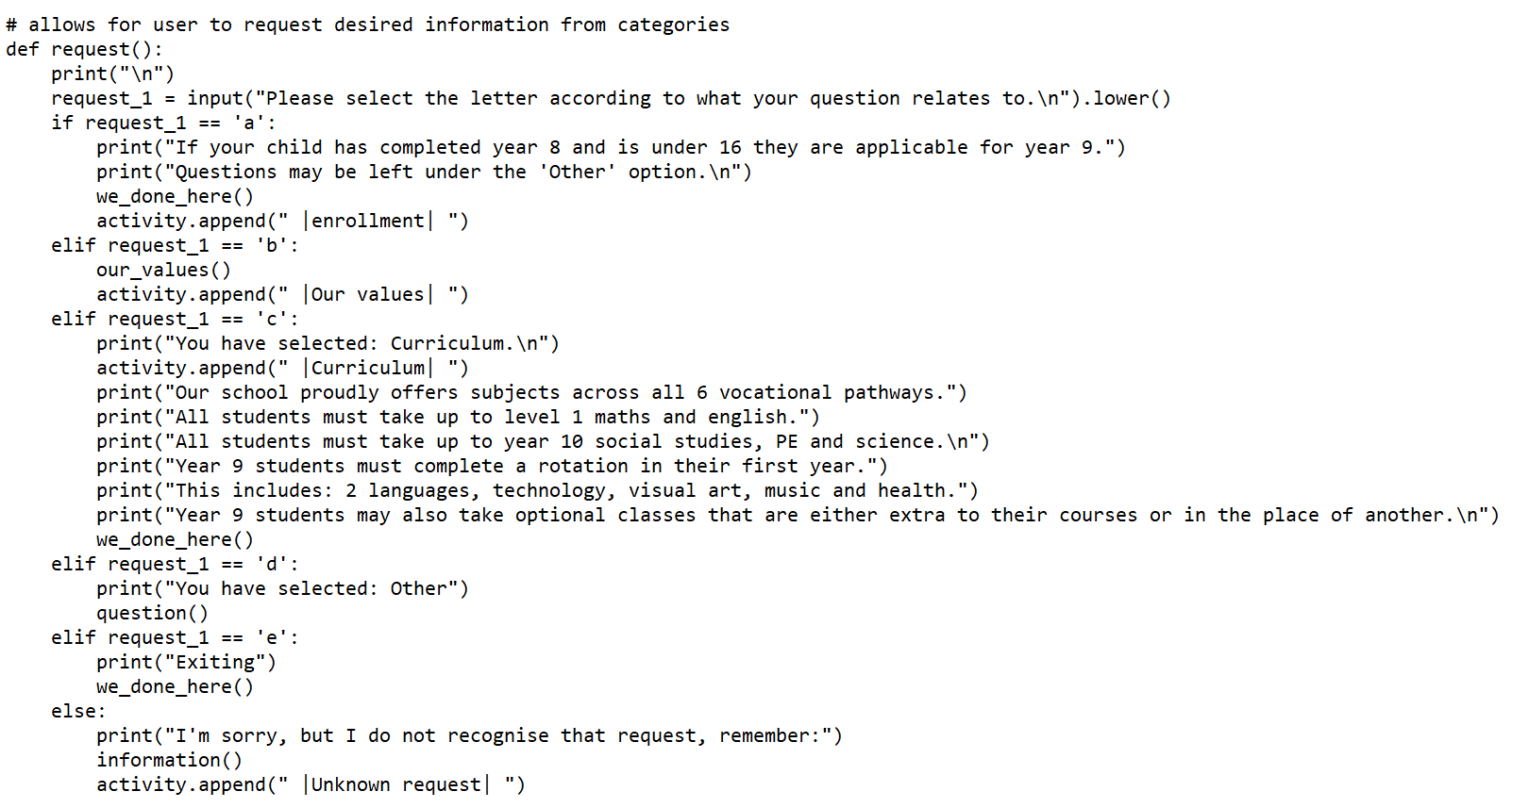
Request function.

Slide 17
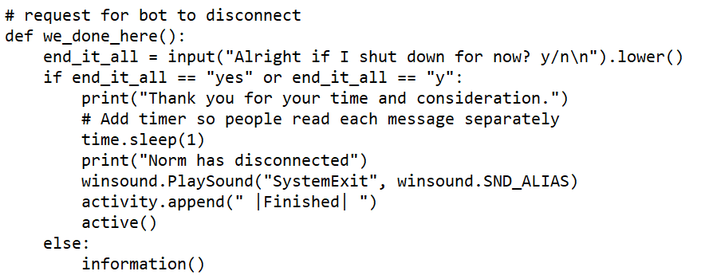
Disconnect (decomposition)
During the time of development the function to disconnect the bot was named we_done_here() and despite the long and arduous name, it meant that I never confused the function again.
The disconnect function is extremely important to my program as I hard coded the program such that users MUST send a request to the bot to disconnect before the program terminates (the request may be them just hitting the x button though).
Since this was the case, a function that tells the bot to terminate the program is extremely important as otherwise the code will run indefinitely. The function only needs one parameter: yes or no, about whether the bot may shut down for the time being. If yes is received, the program terminates. If not, it runs the information function from earlier.

Slide 18
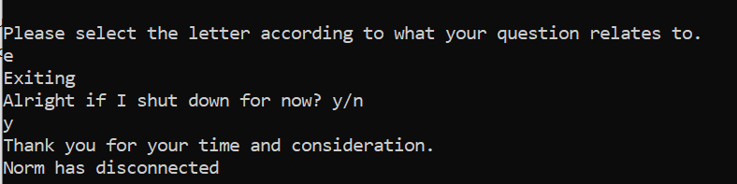
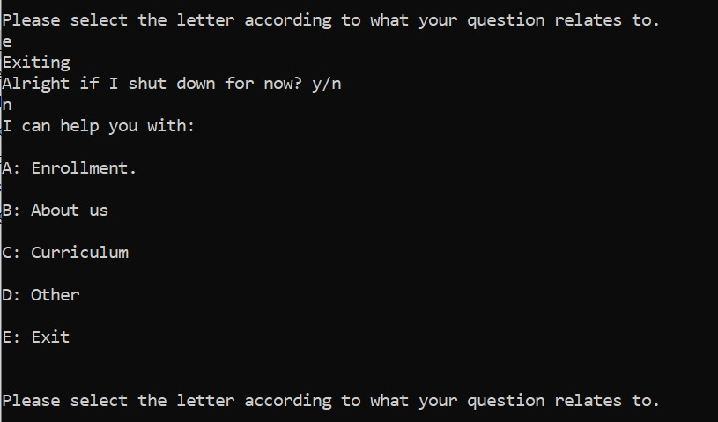
Disconnect requests

Slide 19
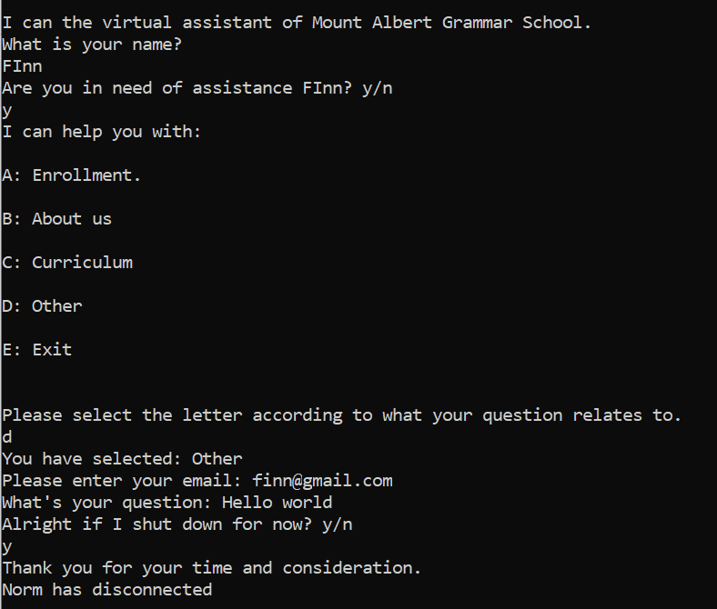
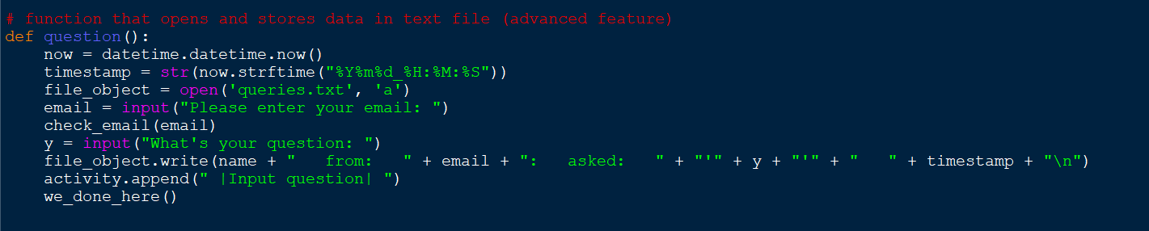
Other (decomposition)
Within the other section I need it to do three things: validate the email, append to the list and then store data in the text file.

Slide 20
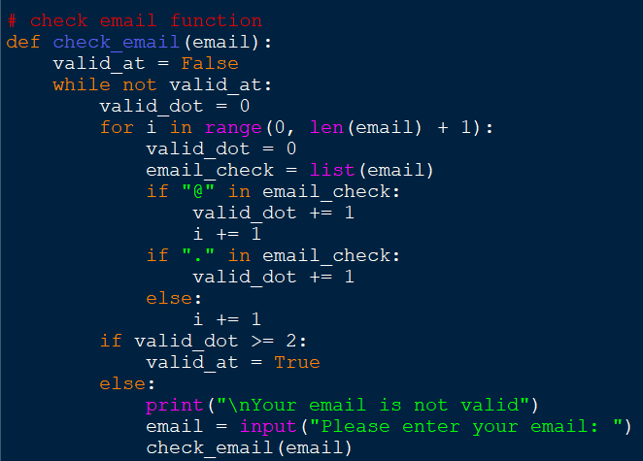
The email validator needs to check for an @ symbol and for at least one . symbol. The email validator must allow for number in the input as well.
Email validator

Slide 21
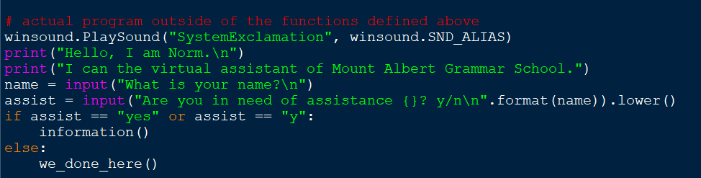
Starting point (decomposition)
The starting point for my code needs to greet the user, and ask if they need help, to make the experience more personable. I included the winsound library so that the bot has start up and closing sounds such that users have an audio cue as to when the program has finished and when it has started. The bot should be able to handle at least “y” and “yes” as inputs for the code, which it will convert to lowercase using the .lower() function before comparing it. It would be ideal if the program could handle other phrases i.e yeah, yep or other languages (oui, ja etc) but that would be such a huge component that I have decided to omit such capabilities at this time. The starting point is also capable of calling the exit function immediately if the need were so to arise.

Slide 22
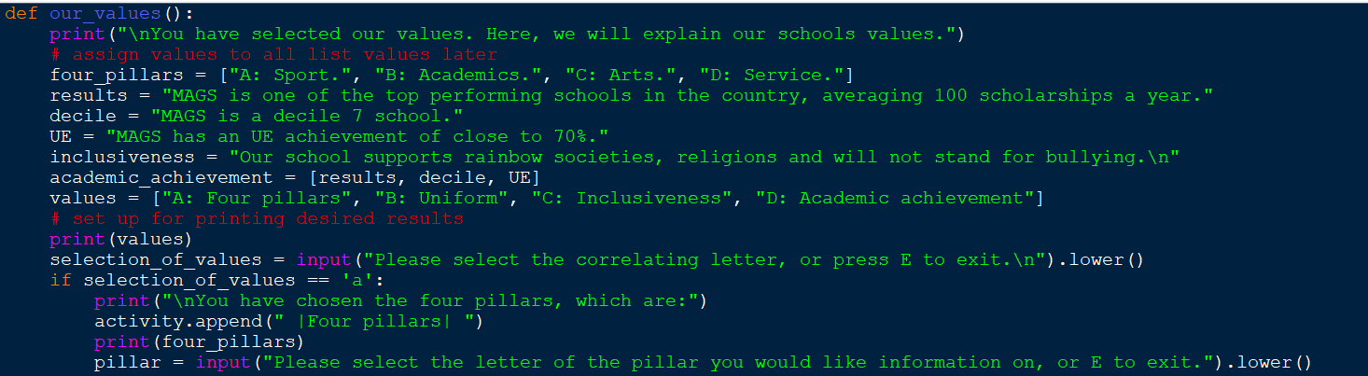
Values (decomposition)
Values will be the largest function in my code as it will include the most options for assisting the user. It will need to include all information regarding the school uniform, pillars, academic results and inclusiveness, including all sub topics within those (male, female, gender neutral, arts, sports, service, academics, decile, UE success rate).

Slide 23
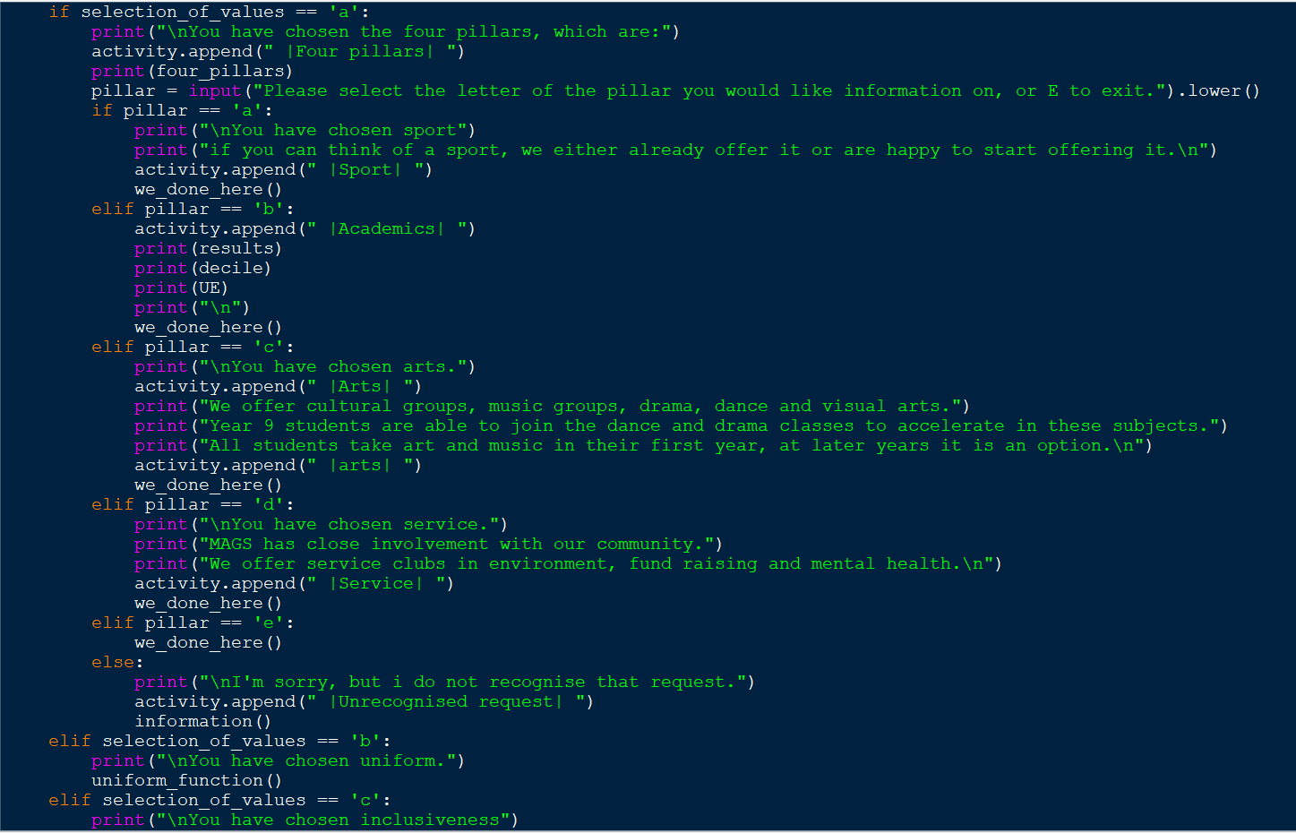
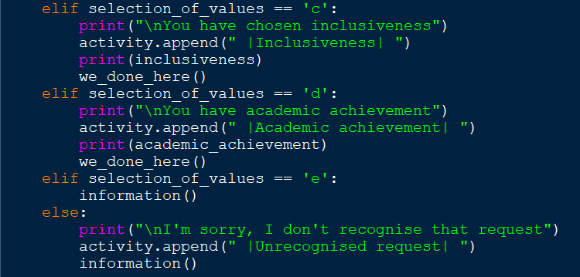
Values continued.

Slide 24
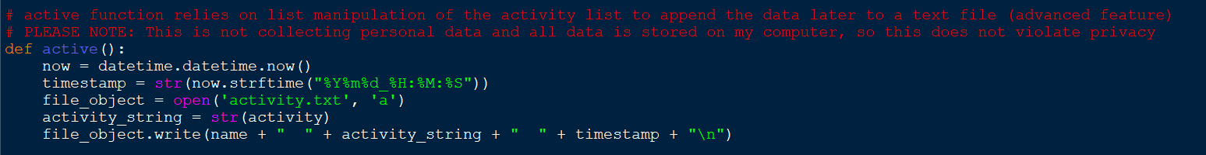
Data collection (decomposition)
Later in my project I decided I wanted to record what users were doing on the bot to supply the client with data they can use to draw statistical conclusions from. By this stage I had worked out how to resolve the issue with storing data in the questions section (other) and knew that I could use the same technology for storing this data. For this section to work efficiently, a blank list will be created with each running of the code that gets all activity appended to it before the list itself gets appended when the user sends the disconnect request.

Slide 25
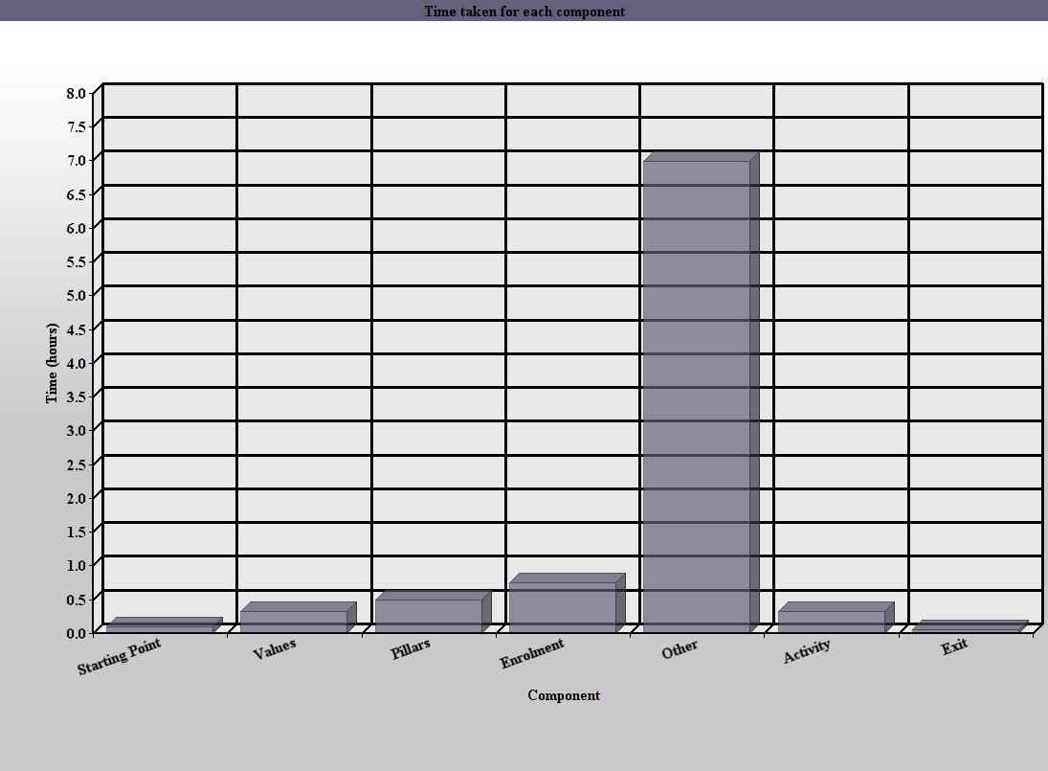
Time taken for each component.

Slide 26
Testing and trialing.

Slide 27
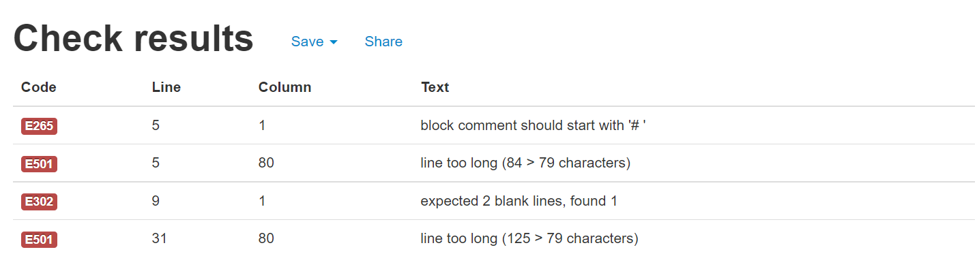
PEP8
Pycharm includes an inbuilt PEP8 checker within the environment that constantly runs checks.
The checker caught numerous errors such as lines being too long, comments not starting the correct symbol

Slide 28
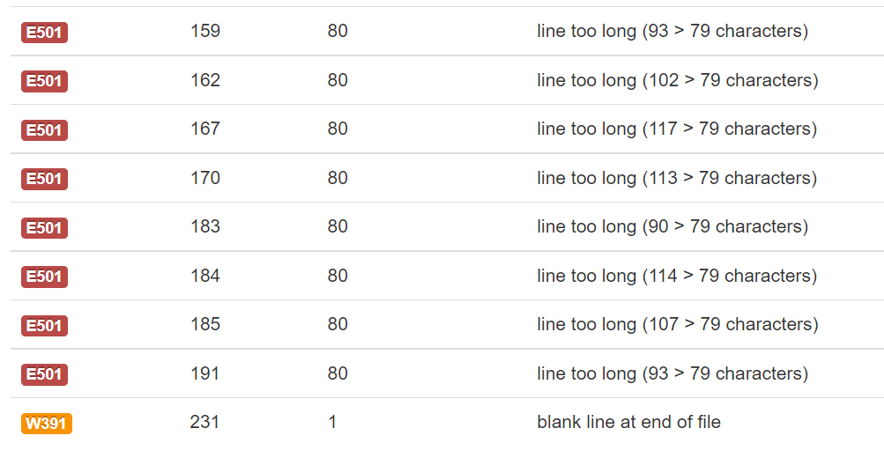
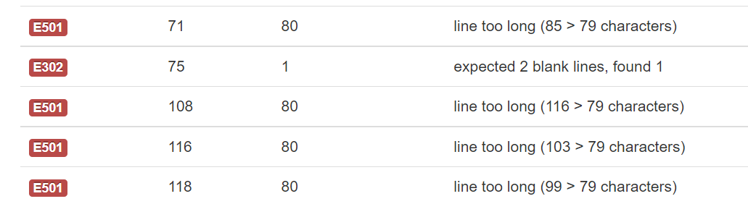
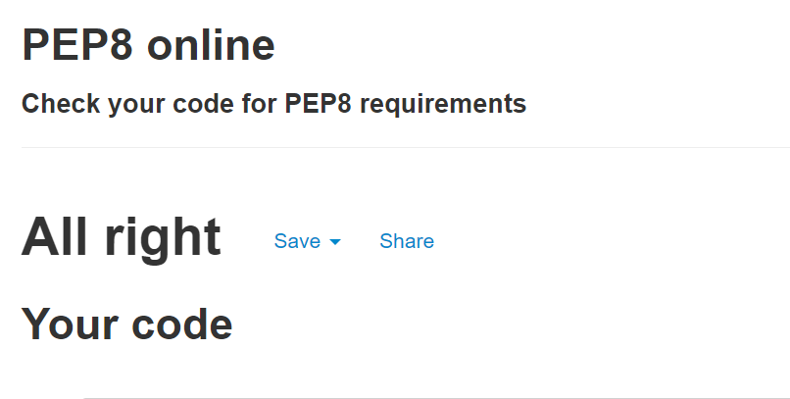
PEP8

Slide 29
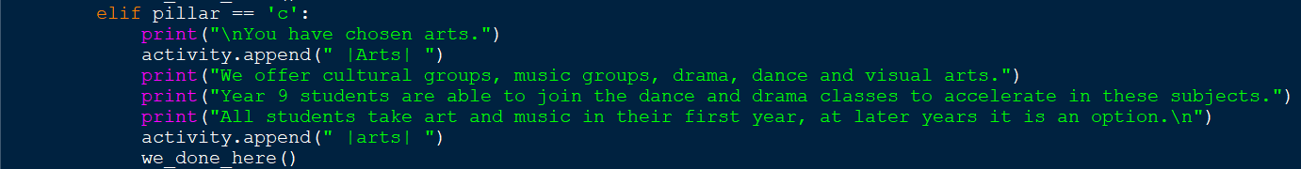
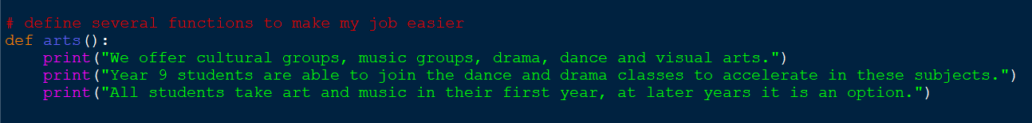
Arts function (component trialing/testing)
The arts information in my code was originally its own function and existed as one for a very long time. I did it as I thought that having it as a separate component would mean that diagnosing an issue in it would be simple.
However, the code is literally three print statements so there isn’t any bug that could occur, and it actually used more lines than just switching it into the pillars section within the loop it was being called in. In testing, the code did exactly what it should: print three lines of code.

Slide 30
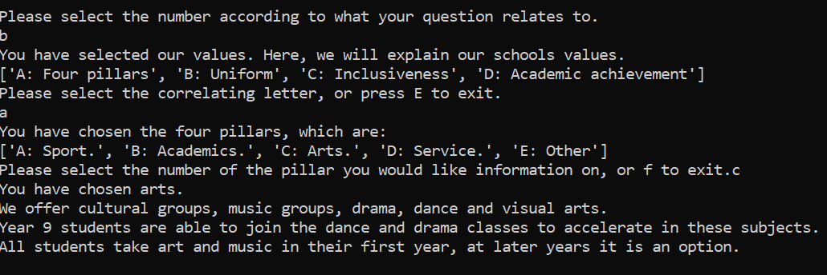
Arts trialing - old version.
In this old version of the code, the program would terminate immediately after the arts function was called due to the we_done_here() program not yet being developed to check if the user actually wanted to exit as a opposed to being forced to. After several trials, I determined that removing the arts function and embedding it’s code in the loop that called it would be more efficient. I wanted to add lines between print statement and that it should check user input before shutting down.

Slide 31
Test number | Test variable | Data | Reason | Expected outcome | Actual outcome | Pass/fail
1 (old version) | VALID | yes | Input to get information. | Prints information | Crashed | FAIL
2 (second) | VALID | yes | Input to get information | Prints information | VALID (but looks ugly) | PASS
3 (final) | VALID | yes | Input to get information. | Prints information | VALID | PASS
4 (final) | INVALID | no | Input to not make the code run | Bypasses code | INVALID | PASS

Slide 32
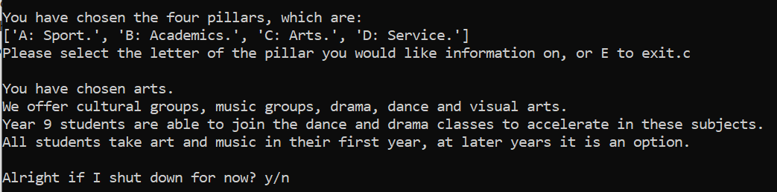
Arts trialling - New version
Changes:
Removed arts function.
Code from function now runs in loop as opposed to loop running function.
Added blank lines between operations in the code to decrease clutter.
Created we_done_here() function.
Added we_done_here() function to the bottom of the about us loop.
There is no way to break this code as it only involves print statements.

Slide 33
Trialing/testing - Arts summary
During the earliest stages of development for this feature, running the function would cause the program to stall and crash. The next iteration worked as intended, printing the correct information. However, my trialing revealed some holes in the discontent: The program terminated without checking with the user, the printed data had no space between the sections making the page looked cluttered and nasty and finally I realised I could pull it out of the function and just run the code straight in the loop. I knew that this final iteration of this section of the code was the structure I wanted so i moved on to testing this section.
Once I finished implementing these features and my testing revealed no holes in the code with it running as expected; printing the desired three lines along with having new lines between the paragraphs, making it look much cleaner.

Slide 34

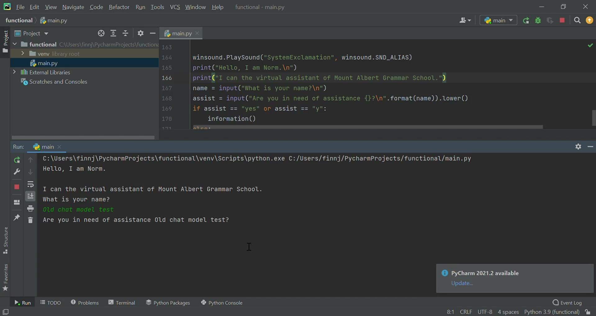
Recordings of earliest arts function iteration.
(Note that it runs normally on Pycharm though)

Slide 35
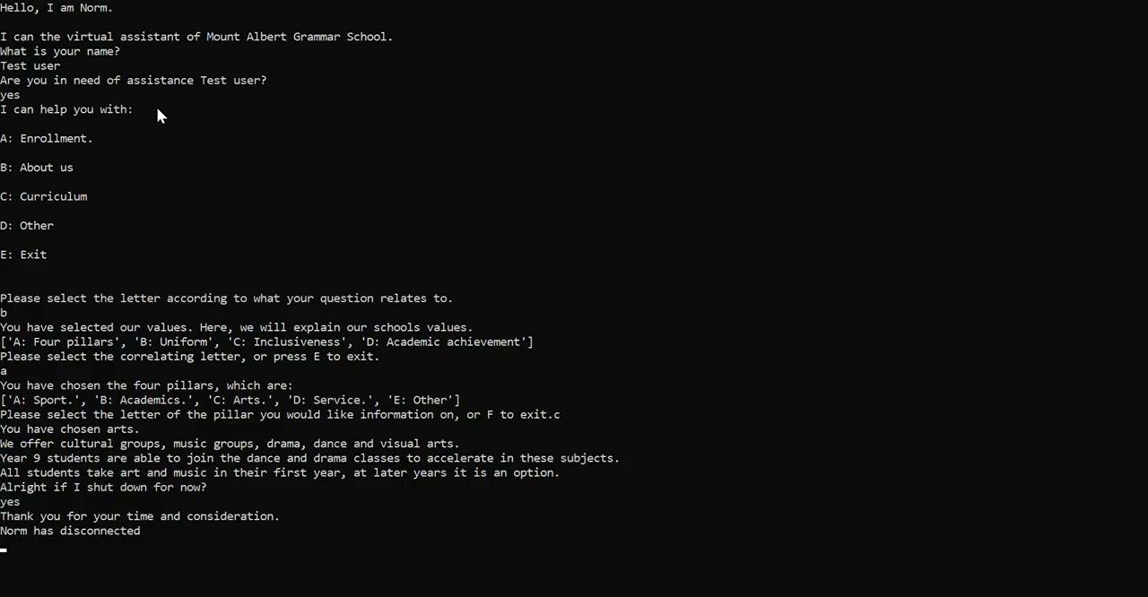
Second iteration of arts function.

Slide 36
Final iteration of arts function.

Slide 37
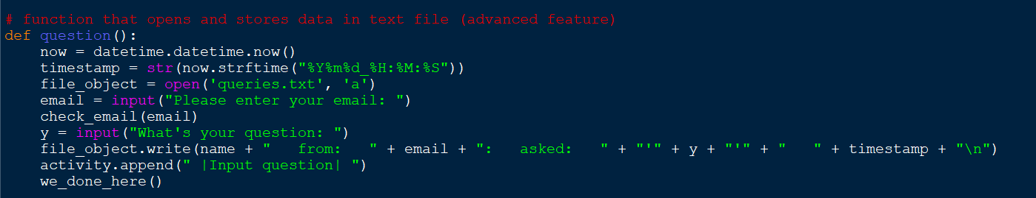
Questions (testing/trialing)
This was the function from hell. The earliest iterations involved appending all data to individual text files. This didn’t exactly work and even if it had, it would have created many different files all occupying space, so I tried to use an excel spreadsheet in tandem with the pyexcel library. This proved to be useless as all data stored in the spreadsheet would get overwritten the minute I opened it again. The earliest trials proved fruitless, yielding only negative results. I would later find a solution thankfully, but this code ended up taking 7 hours from my life writing, trialing and then finally testing.
In the end, the code simply appends all questions to the bottom of the same text file to make organisation easier and use less space. All questions are also time stamped and require the user’s email, such that questions may be answered timely and have an email to answer to.
Unfortunately, since my pycharm project was deleted (stated earlier) I do not have the code to show, but I do have the files that recorded data left over and some screen shots.

Slide 38
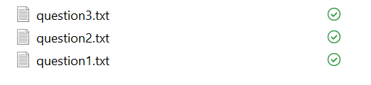
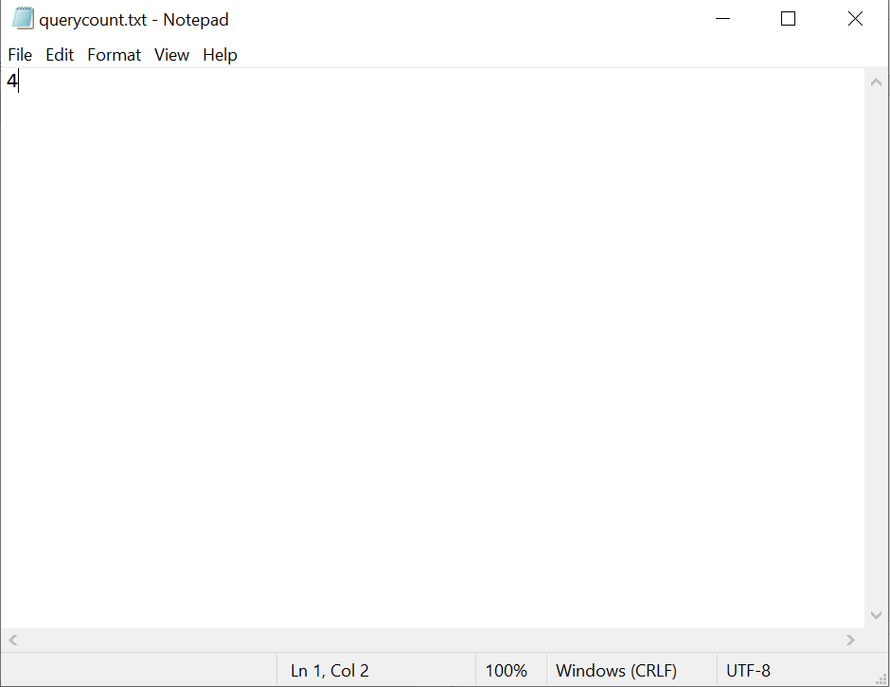
Multi file version.
The earliest function involved the multi file system, where each question would be added to a new file created specifically for holding that exact question. However, trialing revealed that this method would create many files that didn’t even have to store data, where as soon as the user hit enter the file was created, regardless of whether it actually has any data in it or not.
The code involved a separate text file, which the code would read, append to the end of the file name then create the file and increment the number in the file by 1. This means that the files all have separate names meaning that they never overwrite each other. In theory, at the end of the day, the person answering question should need only to reset the number in the file each day to avoid ridiculously long numbers at the end of each file. This method proved clunky and inefficient, so I looked for a better idea.

Slide 39
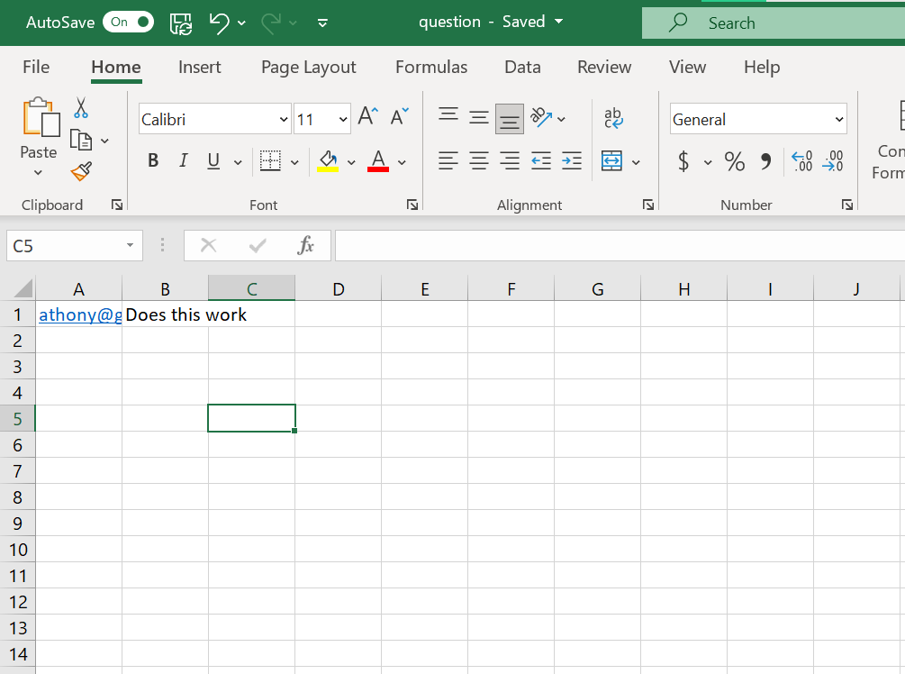
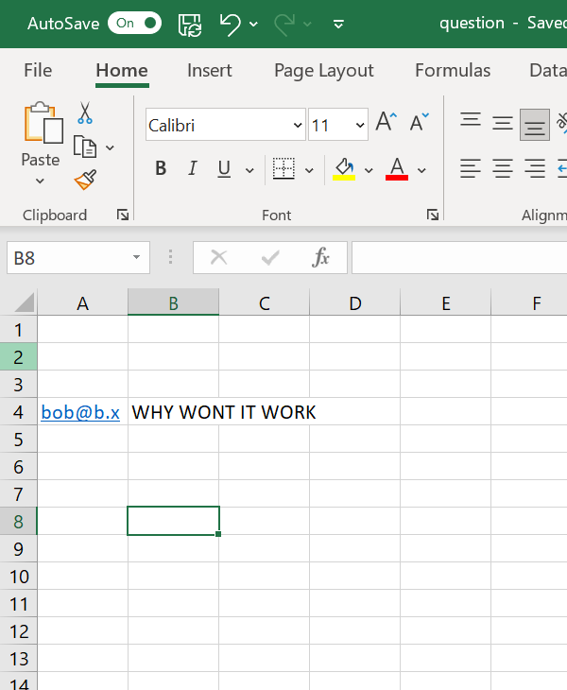
Excel version
THIS version was AWFUL. Trialing showed that the immediate problem I found was that, once I created the excel file, I couldn’t append data to free cells like how .append appends to the bottom of a text file, instead I had to use the write feature of the library. The issue with this is that it doesn’t check for an empty cell, it just overrides the first two cells indefinitely. To fix this, I used the same text file I used for incrementing the number for the multi file system (querycount.txt) and used it to update the number of the cell the information was being appended into The complication found from using this system was that since the spreadsheet is always opened in write mode, the data is overwritten regardless. So now I had a lovely spreadsheet, that appended emails and names down a spreadsheet, but only ever ONE AT TIME making it COMPLETELY USELESS. At first I considered removing the feature entirely, then my final idea struck me.

Slide 40
Final version.
After trialing numerous other ideas I decided to simply append all user questions to the bottom of the same text file and append them with a time stamp. It’s easier, creates less files and can be implemented very quickly.
At first the function was still called ‘excel_sheet()’ before being renamed to question() in the final version.
When I realised that this version was running as i wanted to it to whilst actually recording all the data, I moved it into the testing phase.
The final version also involves more soft commenting where certain variables were renamed from placeholder names (x and y become email and query) to more appropriate name for better understanding in the future. An email checker was also created to minimise the risk of spam and make sure entered emails are valid so that agents do not write answers to non existent email addresses.
Whilst the email address validator took a little longer to iron out all the workings, testing of this version revealed no bugs or error and it handles all errors very well. It is not affected by extremely long questions (though they do look messy in the text file) and the email validator works as intended. The time stamp is also perfectly accurate. If I had to voice my only personal complaint, I’m still not overly happy that I had to resort to text files, as the way they display data is messy and it requires the agent to delete questions once they have been answered (something I’d hope would be automated in the future if I were to return to this project).

Slide 41
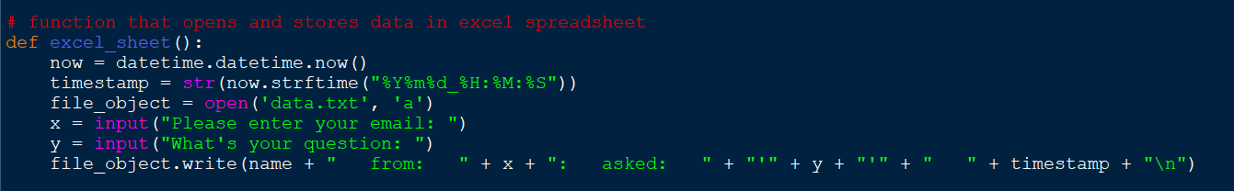
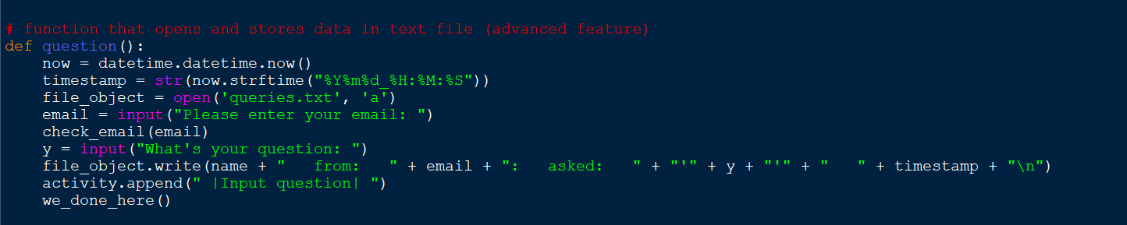
Old then final iterations of the function for the other section.

Slide 42
Test number | Test variable | Data | Reason | Expected outcome | Actual outcome | Pass/fail
1 | VALID | email=finn.lang@gmail.com | Check valid input | Email is valid: Enter questions | Your email is not valid | FAIL
2 | VALID | email=fdelange@students.mags.school.nz | Check valid input | Email is valid: Enter questions | Email is valid: Enter questions | PASS
3 | INVALID | email=Harry | Check invalid input (no @ or .) | Your email is not valid | Your email is not valid | PASS
4 | INVALID | email=harry.com | Check invalid input (no @) | Your email is not valid | Email is valid: Enter questions | FAIL

Slide 43
Test number | Test variable | Data | Reason | Expected outcome | Actual outcome | Pass/fail
1 | VALID | email=finn.lang@gmail.com | Check valid input | Email is valid: Enter questions | Email is valid: Enter questions | PASS
2 | VALID | email=fdelange@students.mags.school.nz | Check valid input | Email is valid: Enter questions | Email is valid: Enter questions | PASS
3 | INVALID | email=Harry | Check invalid input (no @ or .) | Your email is not valid | Your email is not valid | PASS
4 | INVALID | email=harry.com | Check invalid input (no @) | Your email is not valid | Your email is not valid | PASS

Slide 44
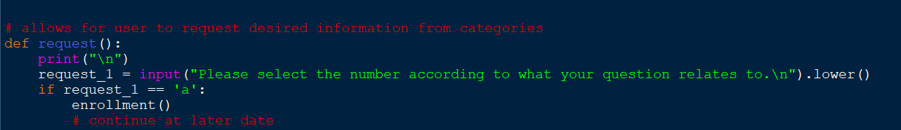
Testing/trialing enrolment.
Enrolment followed a similar development process to the arts function, as it too originally existed as an independent function that was called separately to the loop and run within the request function. As time progressed however, I realised I had overcomplicated the function and I didn’t entirely understand our own enrollment process, so I wasn’t exactly qualified to talk about it nor put it into the bot with assumed knowledge.
Multiple trials revealed that although the code ran perfectly, it just added more unnecessary clutter that could be simplified. For a long time, the completion of the enrolment() function was forgotten as I underestimated my egotistical behaviours and later dissatisfaction with the function. Seen below, in my oldest saved version the code still existed as a separate function yet is denoted with “continue at later date” due to my deciding that other functions were more relevant. I would come to regret this decision.
When I later returned to the enrolment function, my tests indicated that I had inadvertently created functions that linked to inefficient or broken code that couldn’t complete its purpose properly. I would later end up entirely rewriting this feature so that it could run as intended.

Slide 45
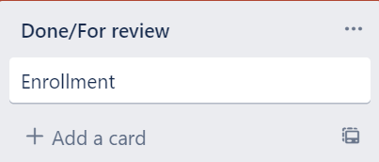
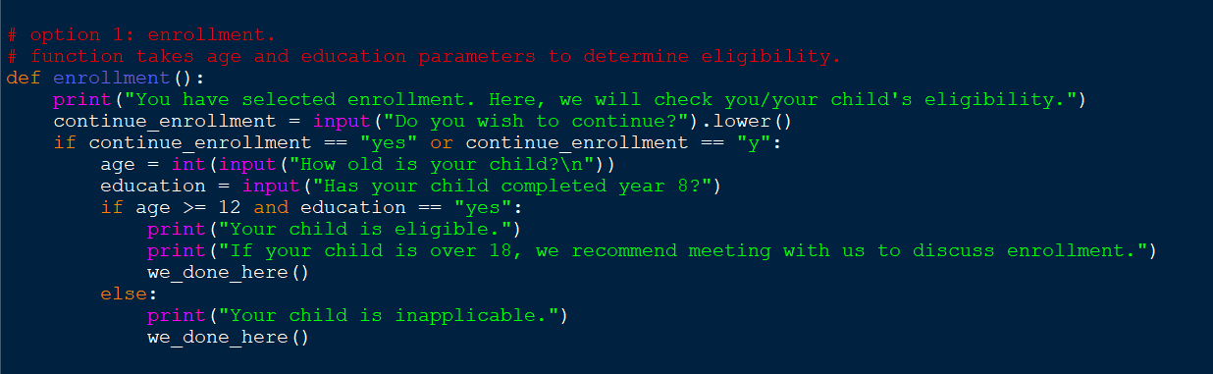
Trials of the oldest version
The oldest version took two parameters: if the individual in question had completed year 8 or equivalent and if the individual was over or equal to 12 years old. The code was bad, sometimes the same inputs put into different IDE’s would get different results and if any unknown key was hit the whole program would terminate. Furthermore, I knew that the terms I had laid out (over/equal 12 and with year 8) were likely to be incorrect so I decided to put the version as completed/for review. I later found the error stemmed from the code not using .lower() properly, nor taking “y” as a valid input only “yes”.

Slide 46
I ended up with about 20 minutes of footage trialing this version where all results were wildly inconsistent and could even change based on whether it was running on the IDLE, pycharm, repl or other IDEs, so I decided to show this footage as it shows one of the only times it completed the task correctly and with the exception values for age (11 and 12) whilst always running with yes as the second parameter to control that variable (control variables are adequately monitored), so that the dependent variable (input) and independent variable (output) can be monitored correctly.
Video of running exception values and standard values in the old version.

Slide 47
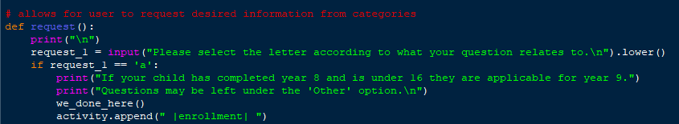
Final version of enrollment
Firstly, I talked to the guidance team and some of the school administration team who said that student enrollment is case dependent in the rare instances of students not following our mainstream process, so my presets were ok, but they recommended I change it so that it included more personal liaising. I agree with this, as I believe a bot cannot solve all problems (unfortunately).
I removed the conditional calculator as testing proved it to be unreliable at the best of times, and replaced it with straight up print statements. I also added the “Questions may be left under other” in the hope people would explore the rest of the bot to try to get answers to their questions. I decided that this would be the final version of this function and thus moved it into the testing stage. At first the tests revealed that I hadn’t put the .lower() command on the user input statement which meant capitalised input caused the program to request new input. After rectifying this line of code, further testing revealed that the code was robust enough to handle varying inputs accurately, before cleanly transitioning to the we_done_here() function.

Slide 48
Final version of enrollment handling both outcomes

Slide 49
Test number | Test variable | Data | Reason | Expected outcome | Actual outcome | Pass/fail
1 | VALID | Continue: y Age: 14 Y8: y | Check valid input | Your child is applicable. | Your child is inapplicable | FAIL
2 | VALID | Continue: yes Age: 13 Y8: Yes | Check valid input | Your child is applicable. | Your child is applicable. | PASS
3 | INVALID | Continue: y Age: 11 Y8: Yes | Check invalid input | Your child is inapplicable. | Your child is inapplicable. | PASS
4 | INVALID | Continue: Age: 12 Y8: No | Check invalid input | Your child is inapplicable. | Your child is inapplicable. | PASS
Testing old version of enrollment

Slide 50
Conclusions from testing.
The program seemed to handle the exception values (12 & 11 for age) correctly and when Y8 was a no, the code properly responded. However, the results of the first test lead me to check the code and found that I was missing .lower() statements for some lines and that it didn’t take “y” as a correct parameter, only “yes” and since there was no .lower() statement, if the user input “Yes” then the code would still output that the child was invalid.
Thankfully, in all situations where an individual should be denied (underage or under educated) the bot responded appropriately, informing the user that they were inapplicable.

Slide 51
Test number | Test variable | Data | Reason | Expected outcome | Actual outcome | Pass/fail
1 | VALID | Continue: y Age: 14 Y8: y | Check valid input | Your child is applicable. | Your child is applicable | PASS
2 | VALID | Continue: yes Age: 13 Y8: Yes | Check valid input | Your child is applicable. | Your child is applicable. | PASS
3 | INVALID | Continue: y Age: 11 Y8: Yes | Check invalid input | Your child is inapplicable. | Your child is applicable. | PASS
4 | INVALID | Continue: Age: 12 Y8: No | Check invalid input | Your child is inapplicable. | Your child is applicable. | PASS
Testing second version version of enrollment

Slide 52
Final thoughts on enrolment.
Despite my tests and corrections finally allowing me to produce robust code that functions as intended, I decided that the function was unnecessary clutter and as earlier discussed, not entirely accurate. Since the new version was just print statements, a testing table would be overkill, so suffice to say that in this greatly simplified version it always ran as intended.

Slide 53
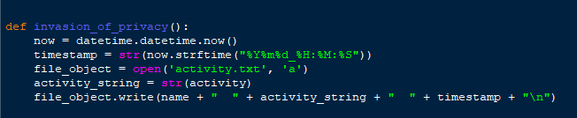
Activity - testing/trialing
The activity function is just modified code from the questions section with list appendation on top of it. To begin with the function was called invasion_of_privacy() because I have a sardonic sense of humour and the code doesn’t actually invade anyone’s privacy, so it was a sarcastic naming convention. However, the name would later change for numerous reasons.
In testing, the code for this always ran as expected. This is because the majority of the code had been appropriated from another function which I had learned from. Since the only difference between this and the other function was that this did not take email as a variable and this one recorded user activity by appending it to a list before appending the list to a text file at the end of the program, it meant very little had to be changed both for users and agents, testing provided very similar outcomes to that of the other function.

Slide 54
Activity - Testing/trialing
Note that in the old version of the code, the function existed, but there was no code that appended data to the list yet, which meant at the end of each run, it appended a blank list to the text file with a name and time stamp.
As seen above, the fourth line contains the append feature that would go on to become very prevalent in my code. At the end of each and every branch, there would be a line like that which simply appends that branch to the list. Originally the appended data was just the text and this was where my problem stemmed from as without the || symbols flanking either side of the text the file would quickly get crammed with disorganised words. Adding the || would make for more compartmentalised and readable files which improves the general experience for agents.
The only issue I ever had with the activity function (note the rename) was that I didn’t like how it formatted itself in the text file. I knew I didn’t have the capability to log the data into a spreadsheet or data frame at the time, but I still wanted the data to be organised enough that it could be used for statistical analysis, so changes had to be made to how data was appended to the list. However, my previous tests had revealed that I did not have the technical skill to develop such a feature yet.

Slide 55
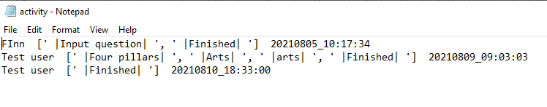
Note that in this dated version, an error in the code caused arts to be appended twice. Whilst the code allows for this, note that one of them is with a capital letter whilst the other is not. This error was quickly caught and rectified.
Testing revealed that in the earlier versions of the code when the arts function was still in development I had recreated the code from the arts function and written it into the four pillars loop without removing the old function. The only thing that caught this error was that I had written one of the arts with a capital and the other without, as well as the fact that I frequently wondered why after getting someone to try break my code arts always seemed to be repeated twice.
Nicely formatted version of the list.

Slide 56
Test number | Does it record the name? | Does it record what they do? | Does it time stamp it? | Are the || signs there? | Does it override data? | Pass/fail
1 | Yes (Test user) | Yes (four pillars, Arts, arts, Finished) | Yes 2021/08/05 10:17:34 | Yes | No | PASS
2 | Yes (Test user) | Yes (Finished) | Yes 2021/08/09 09:03:03 | Yes | No | PASS
3 | Yes (Test user) | Yes (Input question, Finished) | Yes 2021/08/16 09:16:55 | Yes | No | PASS
Testing table for the activity feature.
All these users were different real world people, I made them all use test user for anonymity in my project and to make it more formal.

Slide 57
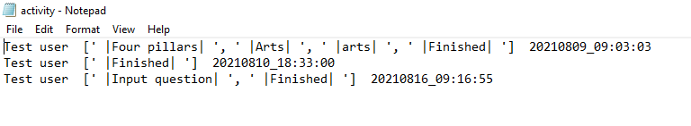
File evidence of users.

Slide 58

General usability - Testing and trialing.
The earliest iterations of the code were missing a vital aspect: exception handling. Since I didn’t develop a GUI the code relies on running in an IDE or terminal, if an unknown command was input, the whole program would either crash, or simply terminate.
For usability, this is detrimental as for users who may struggle with eye sight, reading or perhaps have motor neuron diseases who mistype the request it screws them over immediately. This error was brought to light by user testing from Callum who got sick of constantly having to restart the program to test all aspects of the program.
To rectify this problem, I developed an exception handling piece that loops the user input request statement whenever unfamiliar information is input. This makes the code much smoothe to run. I also found that the fact the bot terminated after each request was inefficient and irritating so I added a user check statement that requires the user to either validate the variable to true or false as to whether they wish to continue on the bot.
Tests for the code identified no bugs or errors, this was expected as the code was developed to be as robust as possible, so I made a loop where if any unknown command was entered the loop would ask for new input. The code below was at the bottom of a long line of elif loops, such that if none of the elifs ran then this runs by default and handles the error by simply asking the user for new input as the previous input was unrecognised.

Slide 59
Applied project management.
I already discussed the majority of project management earlier as to how I used it, so I will briefly recap what I used and how before showing annotated screenshots as evidence.
The main tool I used was Trello. Trello provides a freemium subscription that allows you have several of their boards on going with use of most of the features. I wanted to use software with boards as having a visual roadmap is beneficial to me as an individual and it is vital to one of my techniques I used.
For techniques, the big one was DRY (Don't Repeat Yourself) which centres around the idea of writing a function instead of repeating the same large blocks of code over and over again.
My roadmap was determined by the waterfall methodology, which is a six stage process. My waterfall plan was recorded in a document which has the link attached in one of the above slides. For each and every feature I followed the waterfall method, analyzing, planning, designing, testing and so forth to be certain I was creating the best possible features I could so that I was making the most of my time whilst generating the best results for my stakeholders.
Finally: Kanban. Kanban centres around boards and cards which was one of the reasons I used Trello. Kanban as a method involves producing exactly what is needed in a timely and efficient fashion. It is primarily used for teams as it is based off of agile and DevOps frameworks, but with a little adaptation it worked very well for me.

Slide 60
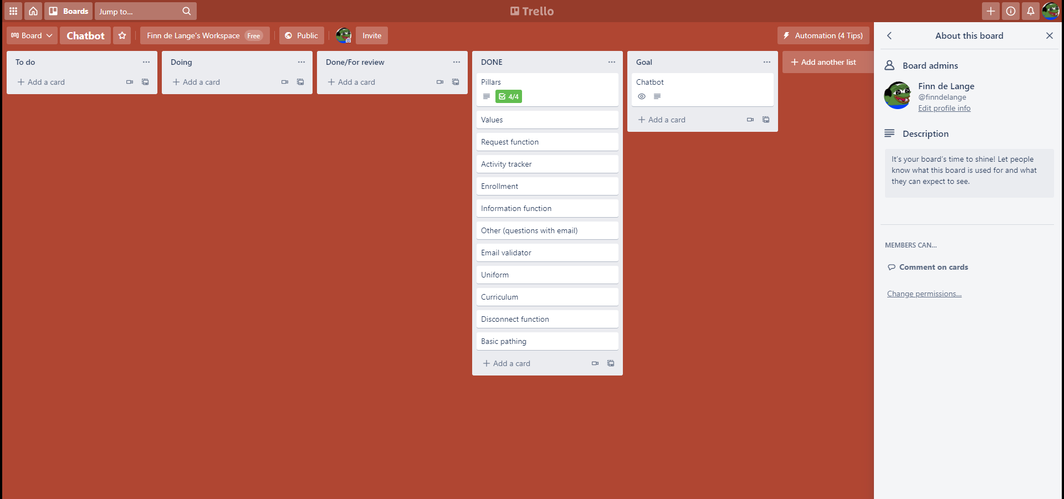
This screenshot is from when I finished reviewing the final component (activity) and could finally move it’s card through to done.
Throughout the process, I alternated between taking one card the whole way at once and moving several up to the reviewing stage. The latter proved to be more beneficial as I found that working on several components and seeing how they would all fit together meant I became good at finding solutions or better alternatives in other features.
Trello

Slide 61
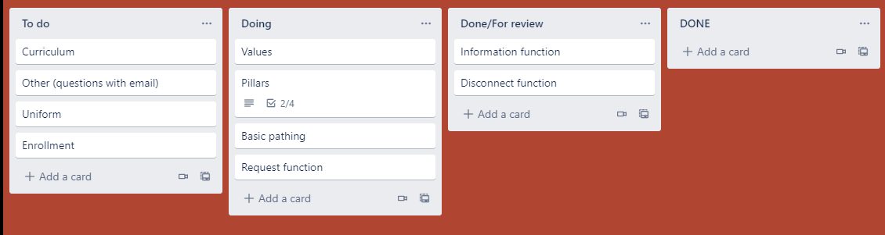
At this stage in the project, I had taken the information and disconnect functions all the way through to review such that I could free up time for working on the more advanced concepts. The pillars section involved subcomponents too small to warrant an entire card so they were added as a checklist under the pillars section, at this stage only the arts and academic pillars were in a completed state.
Trello - A history - Early functions.

Slide 62
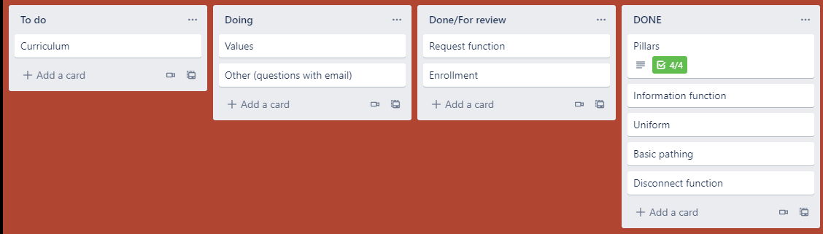
The board did not progress from this stage for many days. The problems that arose from the storing of data on my computer proved to be so difficult that it caused a steep drop off in productivity as I had to dedicate my resources towards finding a solution for that problem. Resultantly, the board did not leave this position for an incredibly long time.
Trello - A history - Dark days

Slide 63

This was in the end game of the project, where I had found the solution for the storing of questions and decided I needed more advanced features, so I created the activity tracker and added the email validator too as a bonus feature.
The email validator went through several iterations and different logic systems for validation of emails, but it moved through to the review section pretty quickly all things considered.
Trello - A history - The end

Slide 64

Trello - A history - Hallelujah

Slide 65
Technique use.
My main objectives in use of techniques was that I wanted to never repeat myself, so I used DRY alot and in some cases I even over used it, creating functions were some were unnecessary which I later removed (arts, uniform).
Kanban was extremely useful as it meant I was able to clearly visualise my goals and next steps on a board with clear cards. Whenever a stage was finished it was moved across the columns as required.
Waterfall was mostly used in my planning stages for what I needed to make, how I would make it and what the requirements were for that specific stage would be. Towards the end of my project I moved more to a method of developing multiple functions at in one go and moving them all to the review stage at the same time, moving more of my project through the waterfall as I went as opposed to taking a single component through at a time.
Most of my evidence regarding the use of these techniques can be found in the previous slides addressing function development and Trello board evolution.

Slide 66
Implications - Privacy.
Privacy surrounds the concept of user confidentiality, making sure that their personal information is safe and will not be leaked or invaded in any such way. It is important that a digital product does not violate privacy in any way such as leaking emails, data or tracking user activity even when off site.
Since I wanted to record data for statistical purposes, I made sure that the program didn’t take this too far such as using cookies or any tracking devices. Instead the program only records name and email for personal information and then what the user does on the bot and on the bot only. There is no way to prevent a user from using a fake name or email address and I do not want a way to stop these things as I believe that people are within their rights to hide their personal identity online.

Slide 67
Implications - Sustainability
Sustainability is about future proofing your product, making sure that in the future it can be update easily and maintained well. It is also about making sure the product lasts and doesn’t just fall apart and need replacement within the foreseeable future. A sustainable product should be easily updated and robust so that it performs its purpose effectively into the future.
During the whole development I had one main goal: Make it sustainable. I developed the bot such that if anyone ever wanted to add or edit it the code is easily laid out and can be added to using functions that the engineer creates to add the desired functionality to the program. This is one of the main reasons I had the bot set up in so many functions, such that it would be easy to add to in the future. The code is also clearly commented such that if coding conventions change in the future it is easy enough to simply rewrite the code in whatever way the new format may be.

Slide 68
Implications - Intellectual property
Intellectual property surrounds the concept of ownership of intangible property such as pictures, patents, code and writing amongst others. It extends to copyright and trademark property as well.
Since I was representing the school, I made sure that none of my work infringes on intellectual property such as copyright, trademarks, images and so forth. Indeed my bot contains no imagery whatsoever and since the bot addresses matters of the school whilst also representing it, it doesn’t infringe on school intellectual property nor the property of any organisation that is not the school.
None of the code is directly appropriated from another individual either, with the most help coming from a stackoverflow forum on the email validator.

Slide 69
Implications - Social
Social implications regard how the product may affect members of society on account of their identity: religion, sexuality, gender, opinions, ethnicity, socio economic status and so forth. It is important that the product is made in a way such that it is non discriminatory and doesn’t make individuals feel targeted or uncomfortable.
My program represents the school, therefore it needs to be as offense adverse as possible, as every year several hundred students are enrolled at the school from varying backgrounds with different identities and it is important that they and their parents can get answers to their questions from a source where they feel comfortable and not targeted. According to this, the bot includes sections on the schools policies around inclusiveness and bullying as well as including a section for gender neutral individuals on the uniform page.

Slide 70
Evaluate.
If I were to start again: I would definitely record more versions. I relied too much on pycharm saving previous versions for me and that backfired horribly. I would use git as well.
I would definitely use Trello, Kanban and DRY again, but I am less sure about waterfall as I found that I sometimes spent too much time evaluating and ended up sometimes overcomplicating the code and making a jumbled mess that often didn’t work and needed great change. To be fair, that is more likely to be me just being a perfectionist, but I found that it consumed far too much time for me to consider using it again.
The planning was extremely useful. I spent a week just planning using waterfall methodology for each and every aspect of the project before I even started coding. I was setting up my Trello, planning my goals and deadlines and checking that I was meeting the requirements for the project. Thanks to all this, I was able to deliver perfectly to time, even with the data storage issue that I ran into, and was able to deliver additional features I hadn’t intended to still within time, improving the quality of the program overall and bringing more value to my stakeholders.
Testing and trialing helped me find better methods of completing the same purpose in my code in more efficient or elegant methods, which improves the quality of the program as a whole and makes it look much cleaner. The testing was vital as it helped me catch bugs, even small bugs that seemed to get through to the final product that I only caught recently whilst reviewing my code (thankfully small bugs).

Slide 71
Discussion
During planning I estimated that the project would take around 14 periods of class work, the equivalent of about 14 hours to complete. Whilst my prediction of this was accurate, due to my perfectionist nature I ended up adding more components and testing and trialing components until I was certain that there would be no better way to construct the code to my knowledge. Thanks to the project management tools and techniques I used I was able to stay on track with a clear idea of what the next component to work on was and thanks to the in depth decomposition done during the waterfall stage I was able to quickly develop components based on a clear blueprint I had previously determined.
It is my firm belief that if I had not used the tools and techniques I had along with my being overly anal about all components that I would not have delivered to schedule and that more bugs would have gotten through to the final product. As it stands, only one bug made it through and it was just a printing error. During the CS50 course I recently learned about git as a version control tool and that you can use repositories on github to a similar effect, concepts I wish I had known about and definitely would have used. In the end, my final product still operated as I hoped it would with full operating capacity and functionality.

